Slide 1
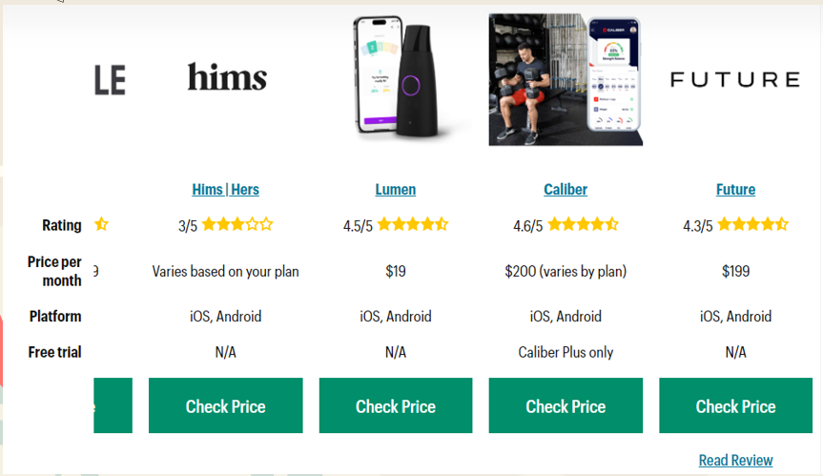
Research:
The problem:
Our Product:
01
03
Obesity
1-Meal Planning
2-Exercise Tips
3-Personal Plan
4-Community Support
02
Research
Market Research:
04

